Slide 1

KEYBOARD SMASHERS _presentation
PINELANDSMUSICSCHOOL
RELEASE_2
Darian Brandt 09167901
Hang Su 09326448
Huisuk GYEONG 09230424
Anneyashan Dey 09534849
Rick Pham 09579249
Ashvin Kanniason 09759522
Nicholas Martin 08623465

Slide 2

Key Requirements
Final solution considered stakeholders:
Students
Teachers
Job seekers
Management team
.

Slide 3
Student Requirements
Learn about Pinelands Music School
Enrol as a new student – will have to wait for approval
.
http://pinelands-music.tk/music_school/home.php

Slide 4
Management Requirements
Approve or reject new student enrolment
Send new student enrolment details – manager must have Microsoft Outlook
.
http://pinelands-music.tk/music_school/home.php

Slide 5
Student Requirements
Log into student portal
Register into a new class
View timetable
View announcements
Review profile
Hire an instrument
Review the teacher’s details for their classes
Log out
http://pinelands-music.tk/music_school/home.php

Slide 6
Teacher Requirements
Log into teacher portal
Review personal details
View timetable
Create an announcement
View musical instruments that can be hired
See the contact details of their students
Sign out
http://pinelands-music.tk/music_school/home.php

Slide 7
Job Seeker Requirements
View available jobs
Apply for a job
http://pinelands-music.tk/music_school/home.php

Slide 8
Management Requirements
View job seeker’s application
Accept or reject application
Email successful applicant their new logon details
Note: New teachers will not have a class to teach until management manually assigns them a class
.
http://pinelands-music.tk/music_school/home.php

Slide 9
Management Requirements
Log in as a manager
Already shown how they accept new students/teachers
Able to view, edit and delete any record on the database
Log in details can only be deleted by deleting the relevant user
Log out
http://pinelands-music.tk/music_school/home.php

Slide 10
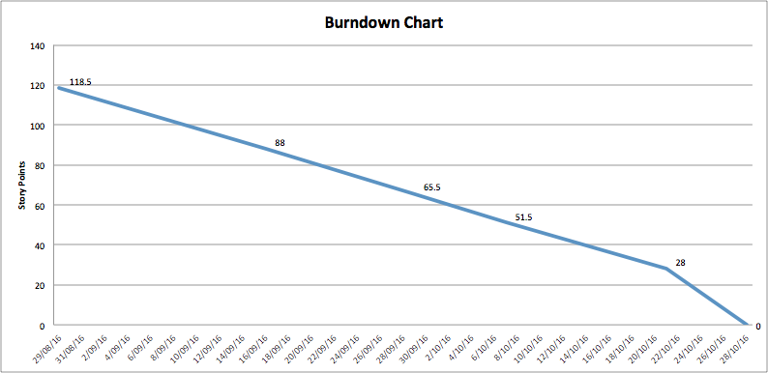
Process – Burndown Charts
.

Slide 11
Process - Velocity

Slide 12
Database

Slide 13
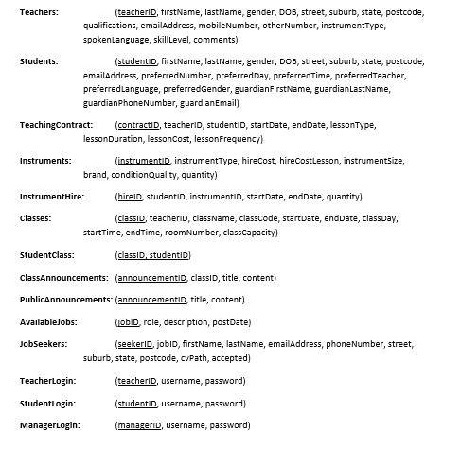
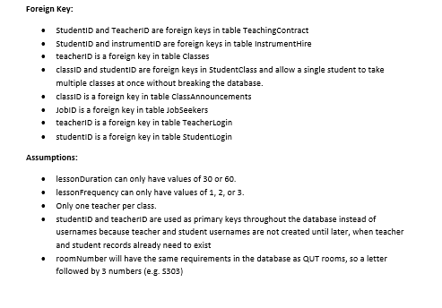
Database

Slide 14
System Architecture
Web server
Amazon
Data
HTML/CSS/Javascript
PHP
MySQL

Slide 15
Future Improvements
Add extra checks in the Careers page for reliability
Add queries tab for admin search
Add access levels in student portal for learning materials
Improve password reset feature
Fix/Delete the search bar
Use salted hash of passwords for authentication

